Slide 1
Obskurní způsoby komunikace
Kubík Hampl

Slide 2
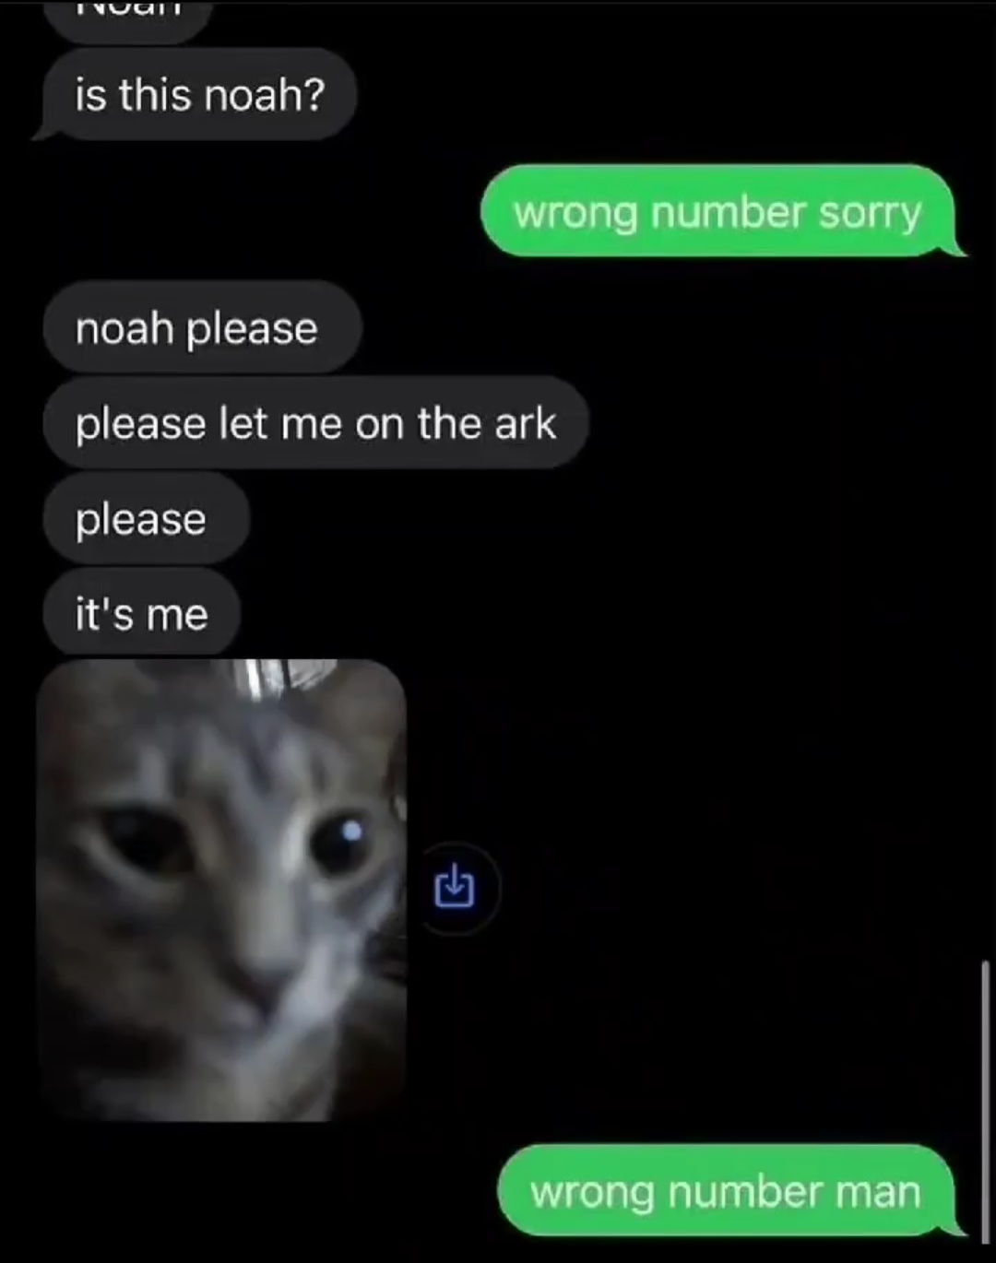
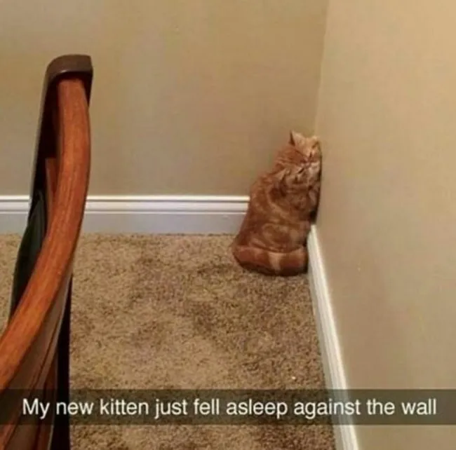
???
na žádné z těchto témat nejsem expert
bude to hodně náhodný

Slide 3
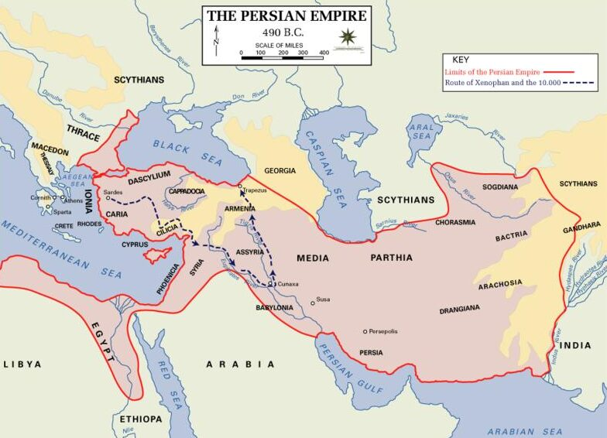
Notes:
https://www.tattoolife.com/wp-content/uploads/2021/11/Geographic-map-displacing-the-borders-of-the-ancient-Persian-Empire-in-490-BC-e1635866413245.jpg

Slide 4
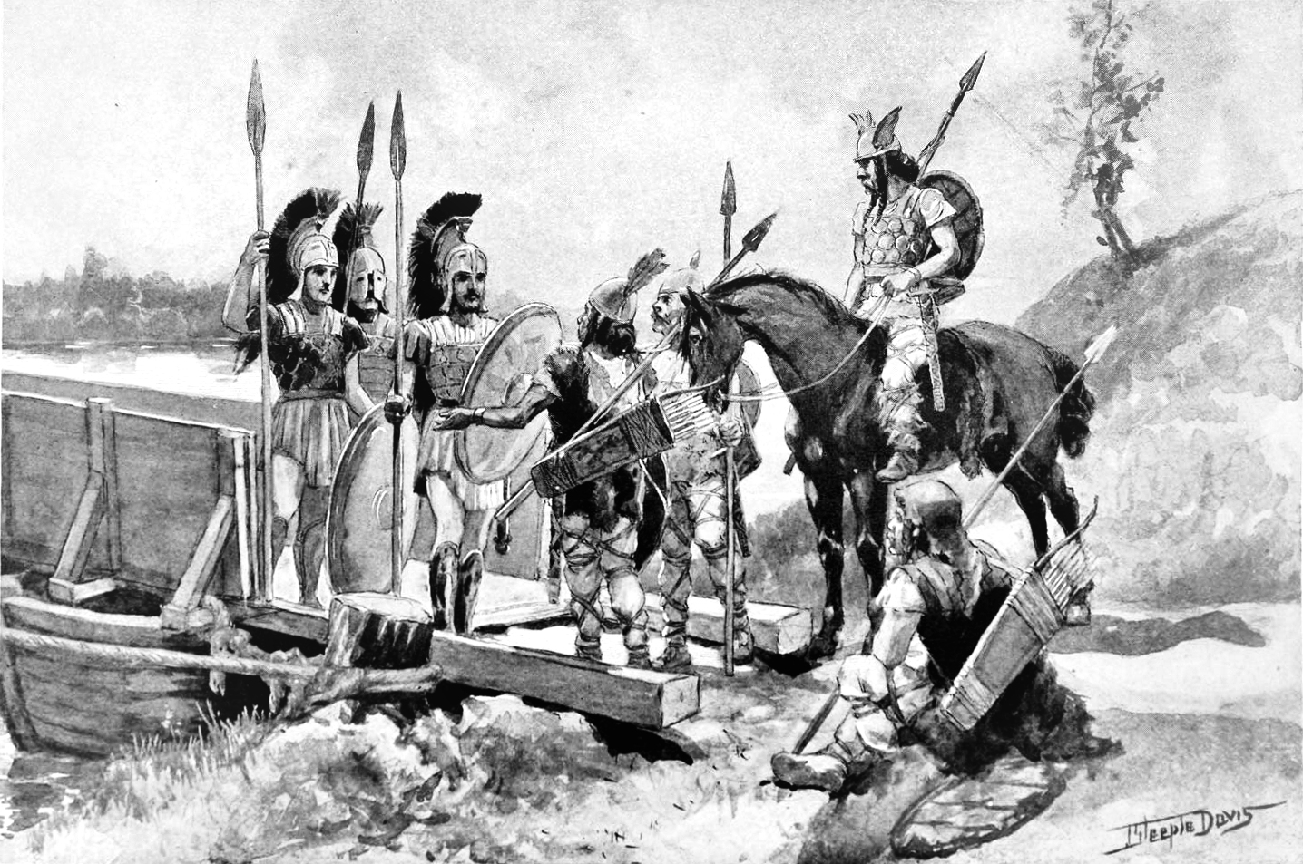
Notes:
https://www.heritage-history.com/books/horne/greece/zpage184.gif

Slide 5
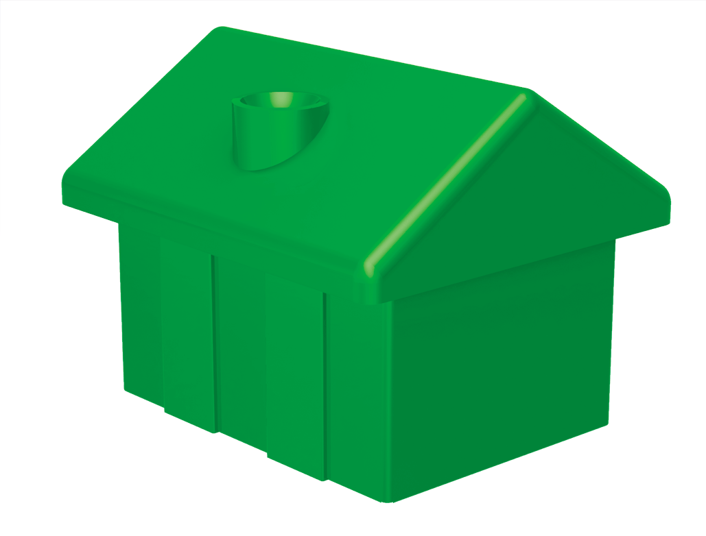
Notes:
https://www.pngkey.com/png/full/227-2275073_monopoly-house-png-monopoly-house-pieces.png

Slide 6
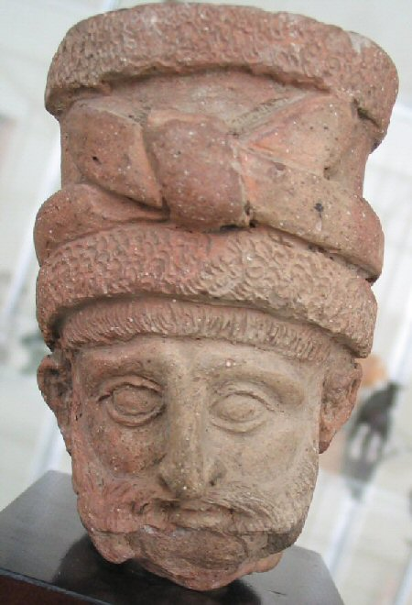
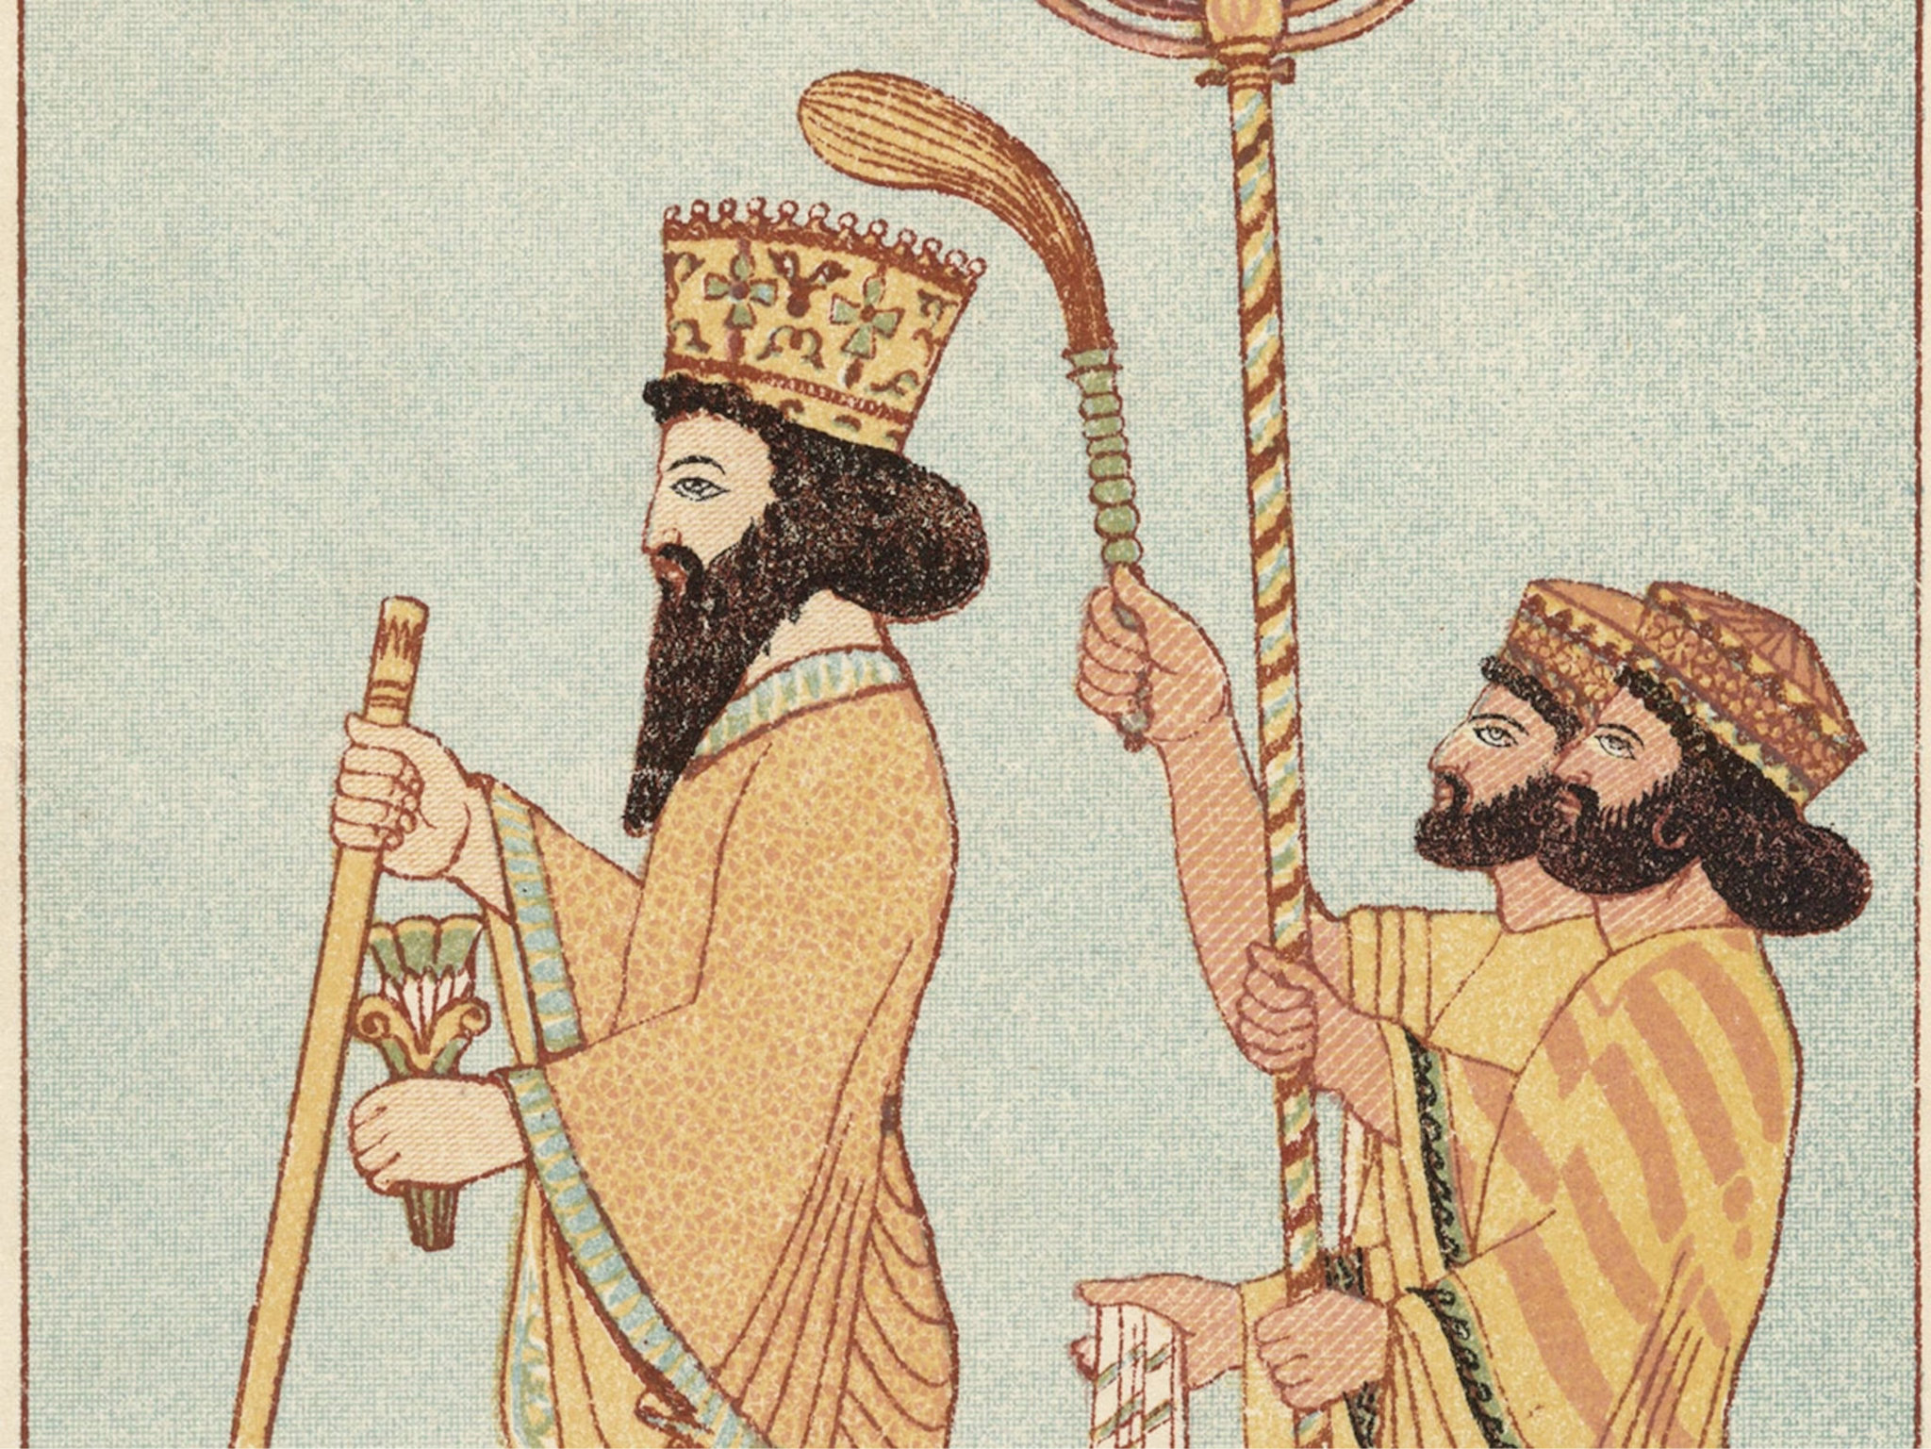
Histiaeus
Megabyzus
Darius
Notes:
https://upload.wikimedia.org/wikipedia/commons/d/d6/Achaemenid_nobleman_520-480_BCE.jpg
https://i.natgeofe.com/n/2710b9ca-746f-49b2-aca2-cc289eb8130c/01-darius-i-ancient-figures_4x3.jpg

Slide 8
Notes:
https://iranparadise.com/wp-content/uploads/2019/06/Ancient-City-of-Susa.jpg

Slide 9
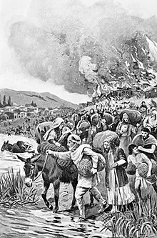
Notes:
https://upload.wikimedia.org/wikipedia/commons/thumb/c/c5/The_burning_of_Sardis_during_the_Ionian_Revolt.jpg/220px-The_burning_of_Sardis_during_the_Ionian_Revolt.jpg

Slide 10
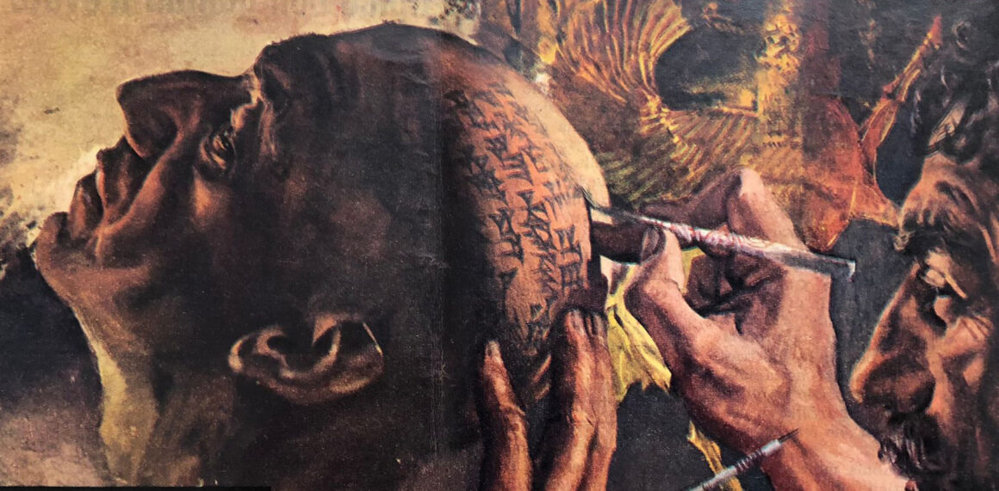
Notes:
https://www.tattoolife.com/wp-content/uploads/2021/11/Detail-of-an-illustration-by-Giorgio-De-Gaspari.jpeg

Slide 11
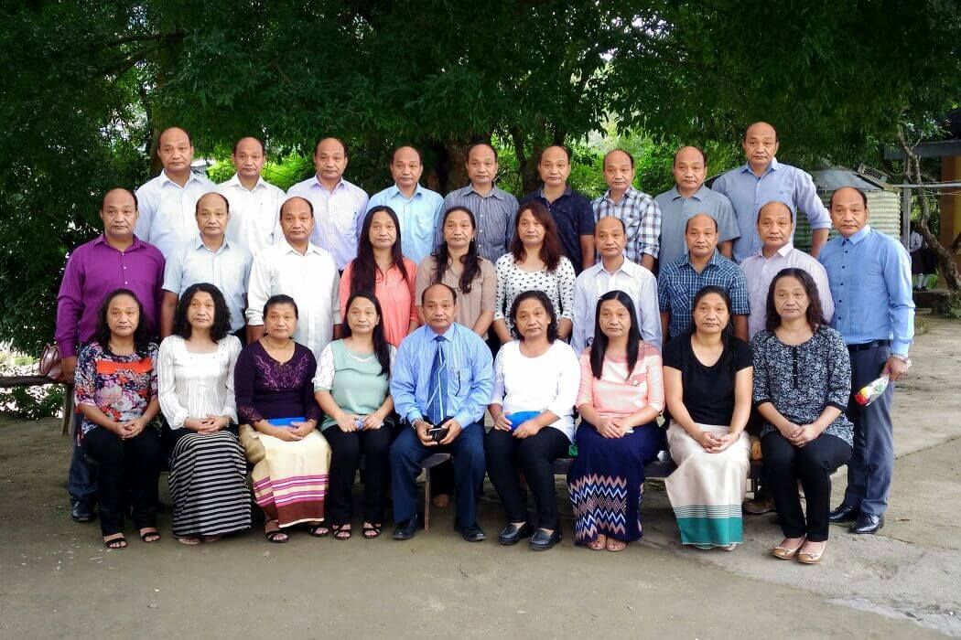
Notes:
https://i.seadn.io/gae/sV-lfiiIl2J6ATPN0_r1BkeZMJ2AqBlcHcpAZcqMbdbCmqguQfQ0j0lMTdNQ_VR4GjY6aS8HUrg0ttJz_gRKijBkfFFhkdrkSx7x0Q?auto=format&dpr=1&w=1000 https://dbuhyrqqtene9.cloudfront.net/wp-content/uploads/2017/01/8th-wonder-28-members-with-same-face-in-a-family.jpeg

Slide 12
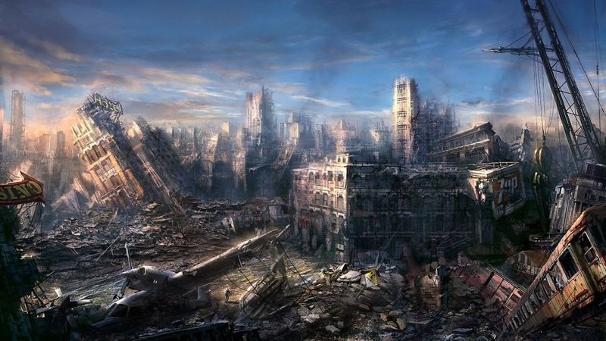
Notes:
https://i.pinimg.com/originals/8d/04/49/8d04490cf3f3451594d65426985d252e.jpg

Slide 13
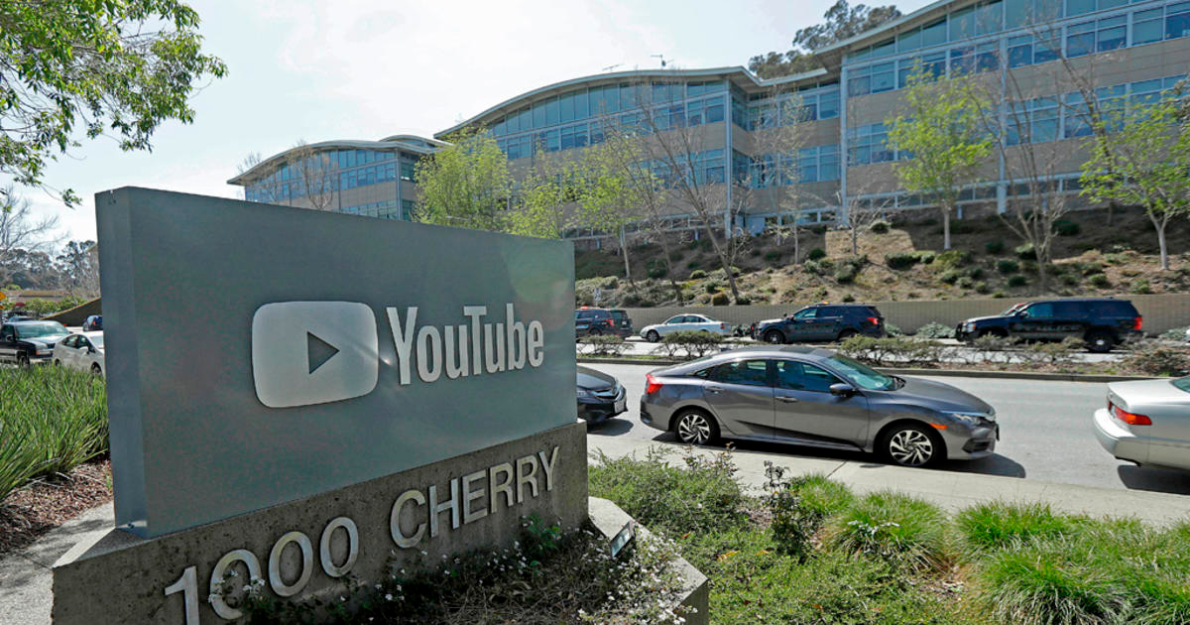
Notes:
https://www.youtube.com/results?search_query=proces+kafka+audiokniha

Slide 14
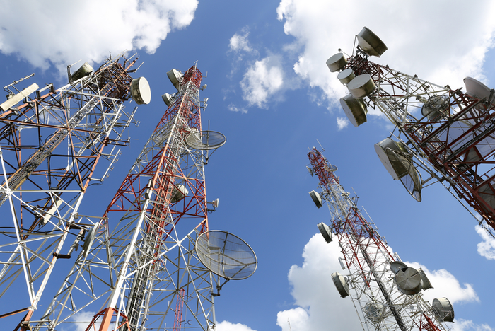

Slide 15
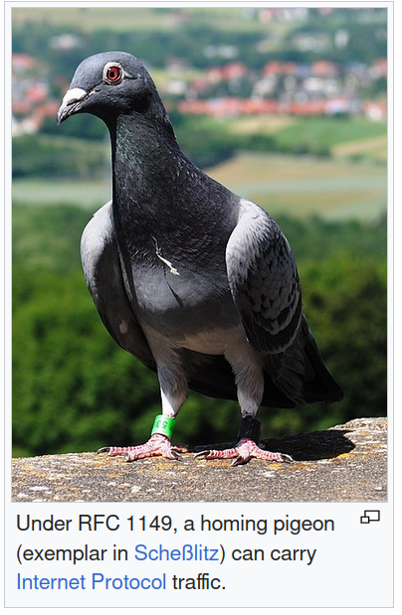
I P o A C
nternet rotocol ver vian ariers
Internet Engineering Task Force
Notes:
https://en.wikipedia.org/wiki/IP_over_Avian_Carriers
https://en.wikipedia.org/wiki/Internet_Engineering_Task_Force

Slide 16
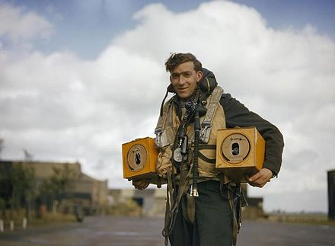
Notes:
https://upload.wikimedia.org/wikipedia/commons/thumb/4/43/Avro_Lancaster_pigeons_WWII_IWM_TR_193.jpg/440px-Avro_Lancaster_pigeons_WWII_IWM_TR_193.jpg

Slide 17
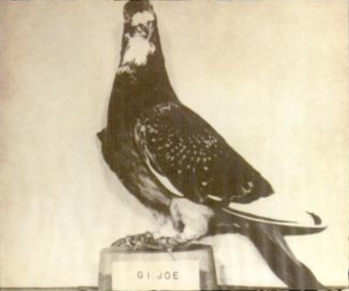
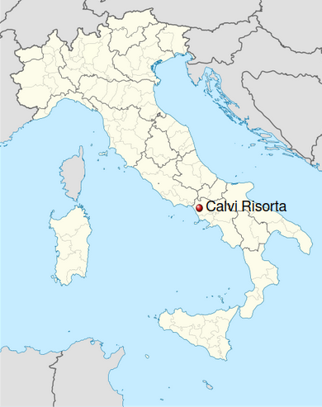
Notes:
https://upload.wikimedia.org/wikipedia/commons/2/23/GI_Joe_Pigeon.png
https://upload.wikimedia.org/wikipedia/commons/thumb/1/16/Italy_provincial_location_map_2016.svg/500px-Italy_provincial_location_map_2016.svg.png
https://en.wikipedia.org/wiki/Dickin_Medal

Slide 18
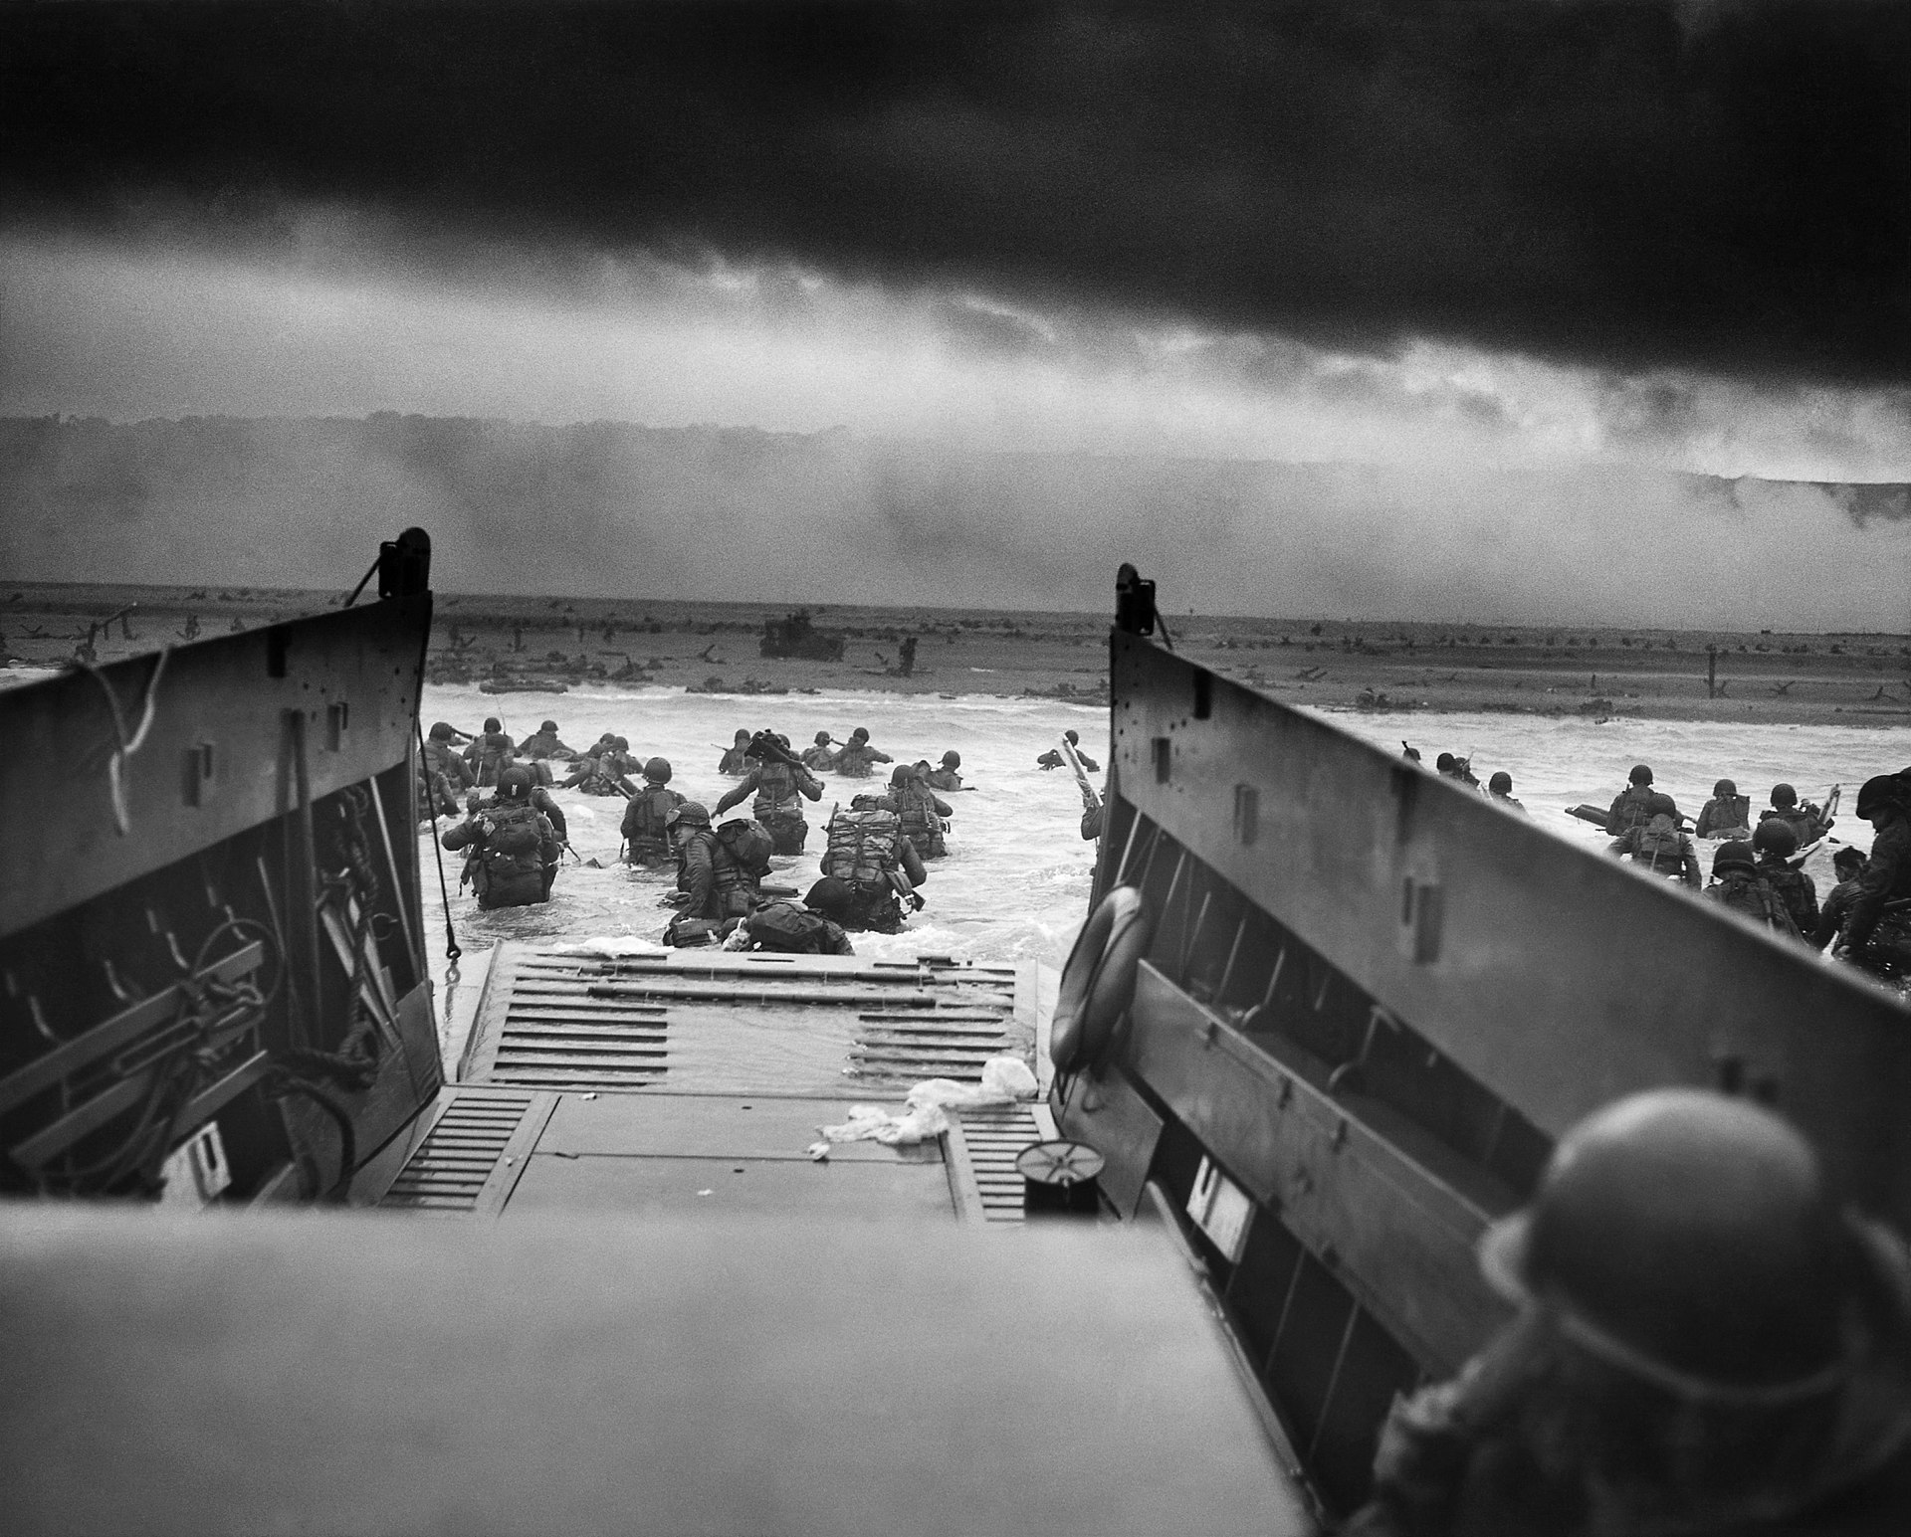
Notes:
https://upload.wikimedia.org/wikipedia/commons/thumb/a/a5/Into_the_Jaws_of_Death_23-0455M_edit.jpg/285px-Into_the_Jaws_of_Death_23-0455M_edit.jpg

Slide 19
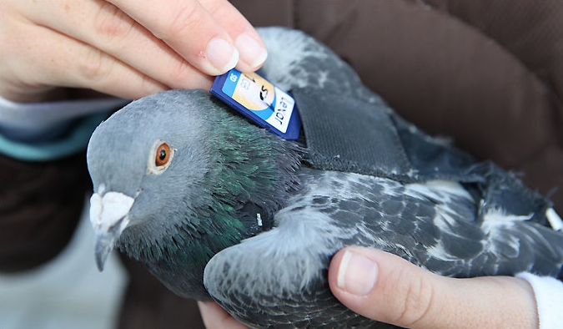
Notes:
https://i.imgur.com/gJOM0u7.jpg

Slide 20
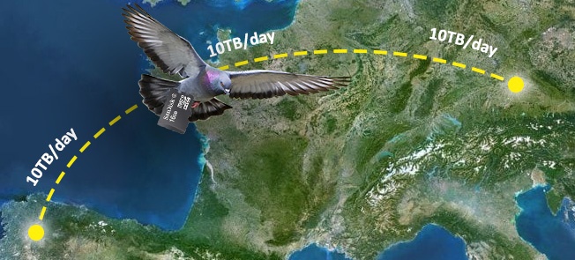
Notes:
https://www.open-e.com/about-us/news/newsletters/marketing-newsletter-open-e-joviandss-updated-with-new-protocol-users-en/

Slide 21
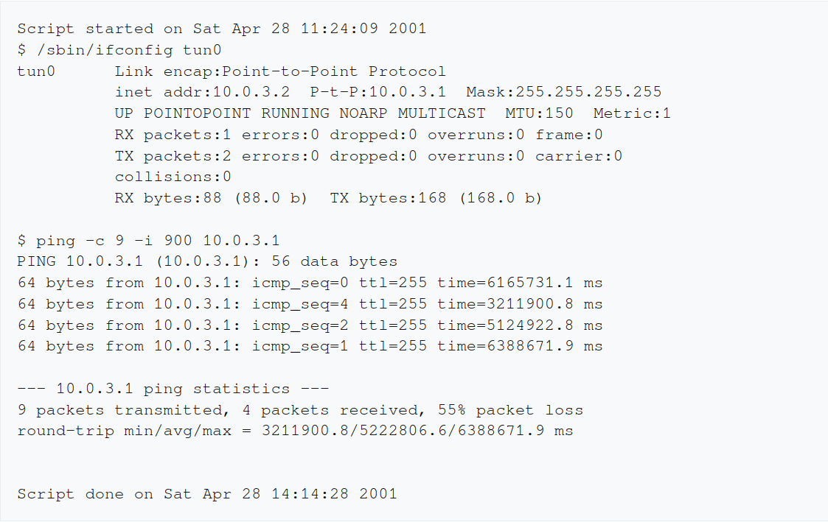
53 / 87 / 106 minut
Notes:
https://en.wikipedia.org/wiki/IP_over_Avian_Carriers

Slide 22
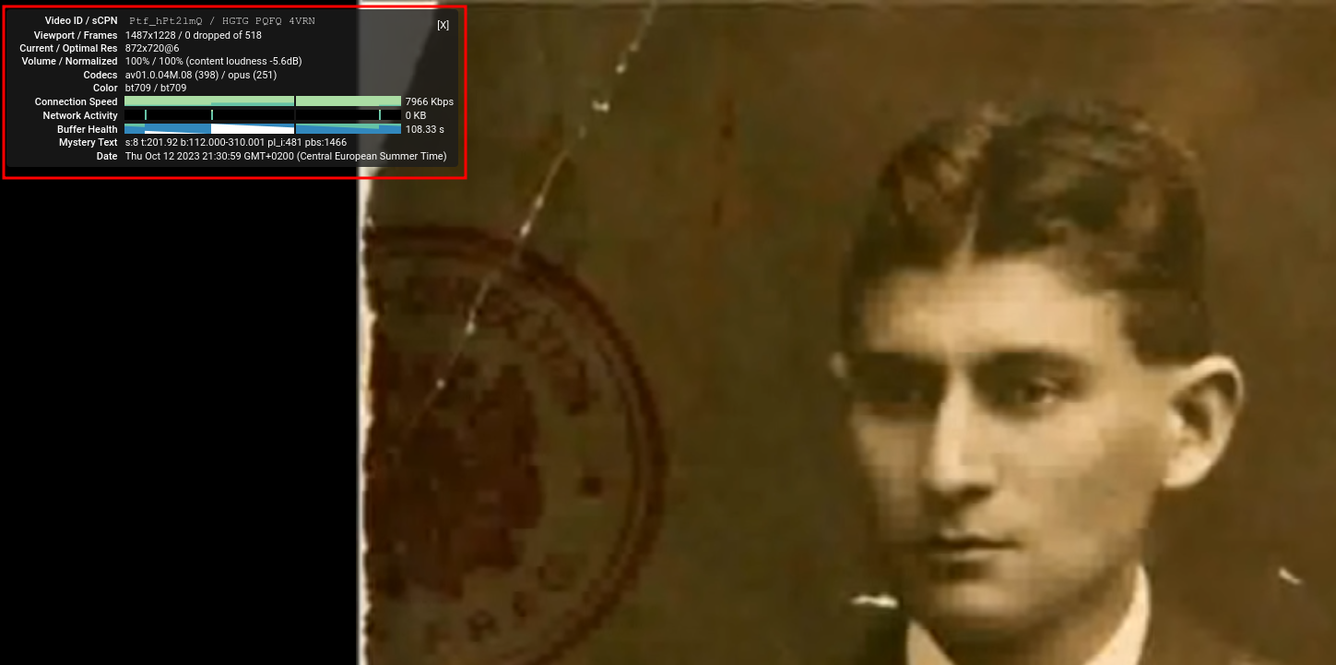
Notes:
https://www.youtube.com/watch?v=Ptf_hPt2lmQ&t=115s

Slide 23
935 134 200 holubů
~ 30% HDP USA
Notes:
https://www.postovniholub.cz/cenik-postovnich-holubu.html

Slide 24
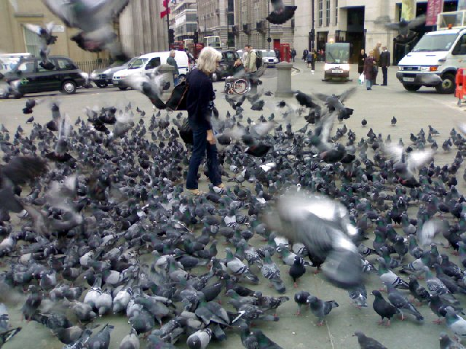
Notes:
https://live.staticflickr.com/4126/4953735466_bc6dd1528b_z.jpg

Slide 25
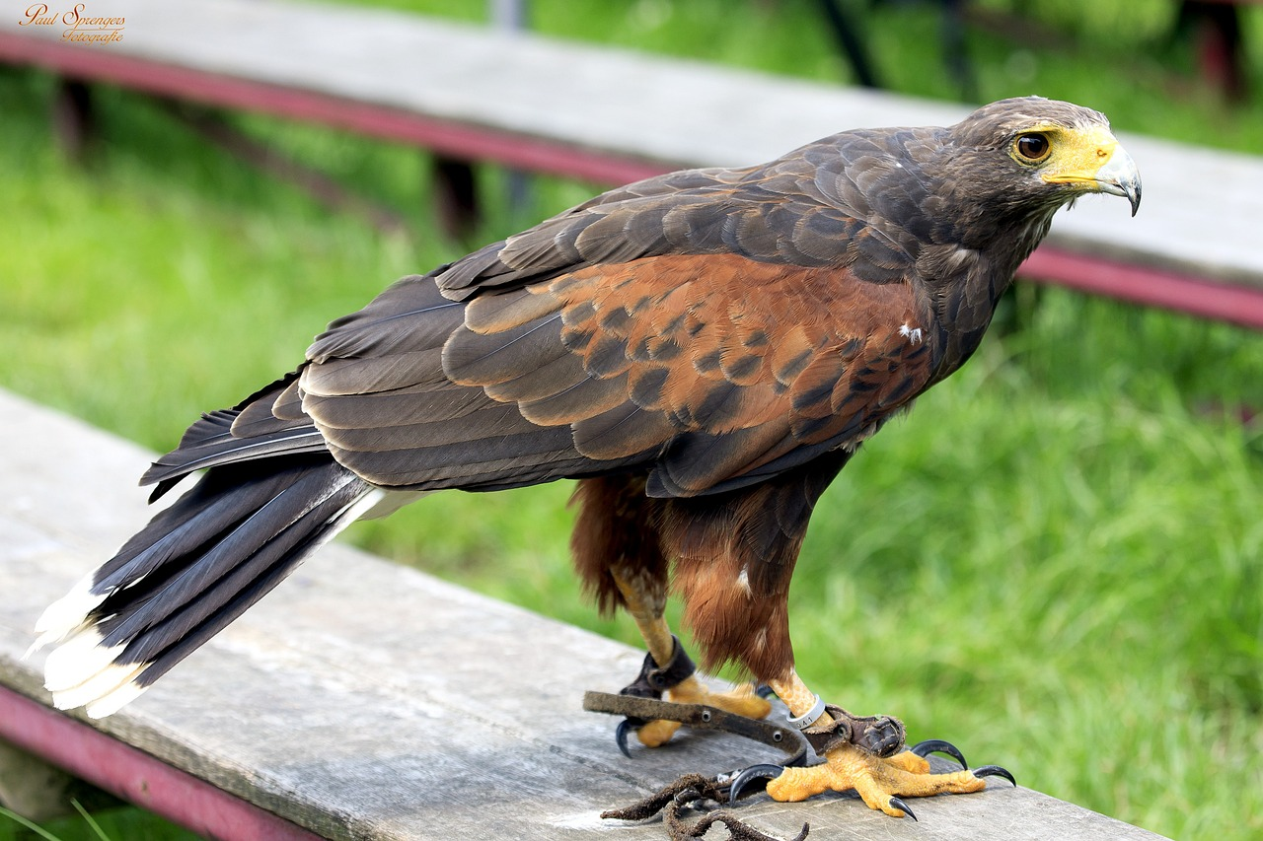
Notes:
https://cdn.pixabay.com/photo/2013/09/30/22/10/bird-of-prey-188817_960_720.jpg

Slide 26
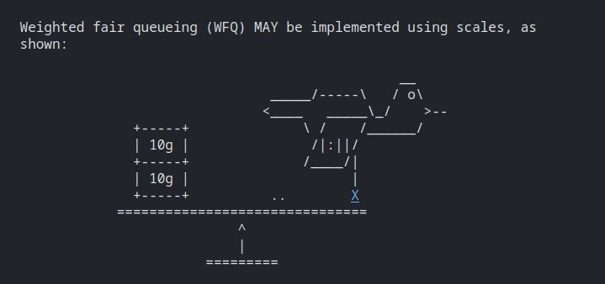

Slide 27
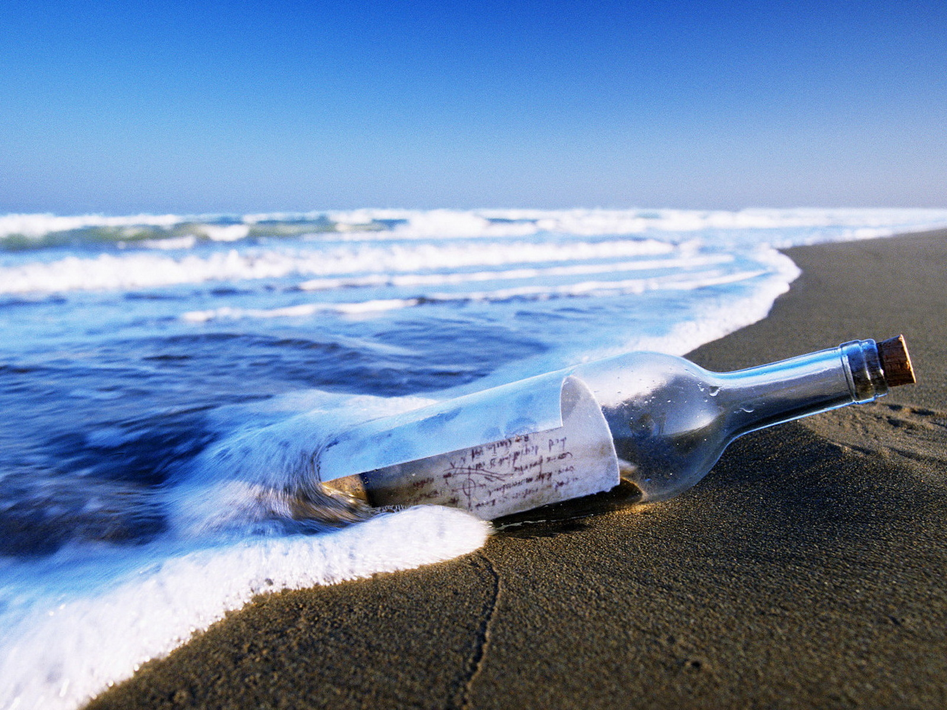
Notes:
https://external-content.duckduckgo.com/iu/?u=http%3A%2F%2Fwww.zastavki.com%2Fpictures%2F1600x1200%2F2010%2FArchive_Miscellaneous_Message_in_a_bottle_022915_.jpg&f=1&nofb=1&ipt=55204b1894ea3db74d8ecabefadcaf573f3dd8130c9e0954230099ee6db455a2&ipo=images

Slide 28
Notes:
https://upload.wikimedia.org/wikipedia/commons/thumb/f/f0/20160728MessageInBottleComposite.png/660px-20160728MessageInBottleComposite.png

Slide 29
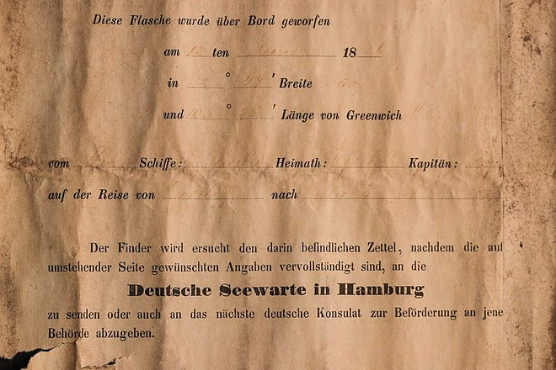

Slide 30
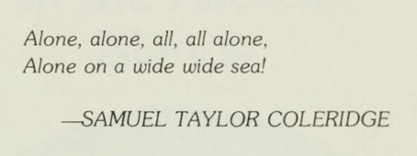
Notes:
https://archive.org/details/twelvemilliondol00kras/

Slide 31
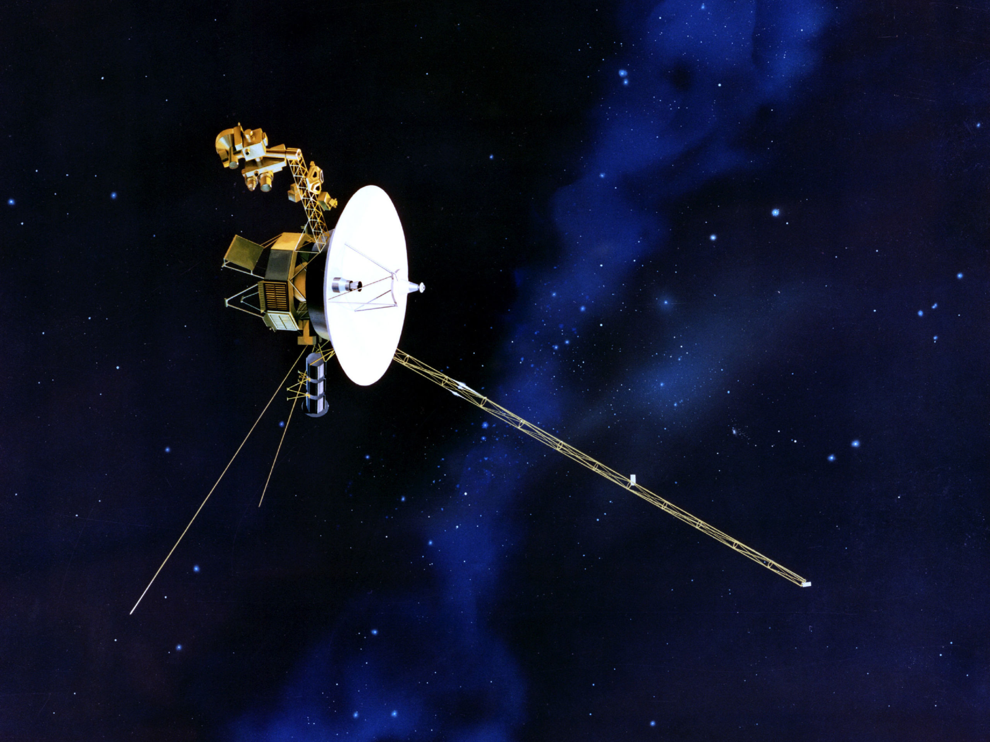
Notes:
https://pop.h-cdn.co/assets/17/36/2560x1920/sd-aspect-1504620396-voyager-spacecraft.jpg

Slide 32
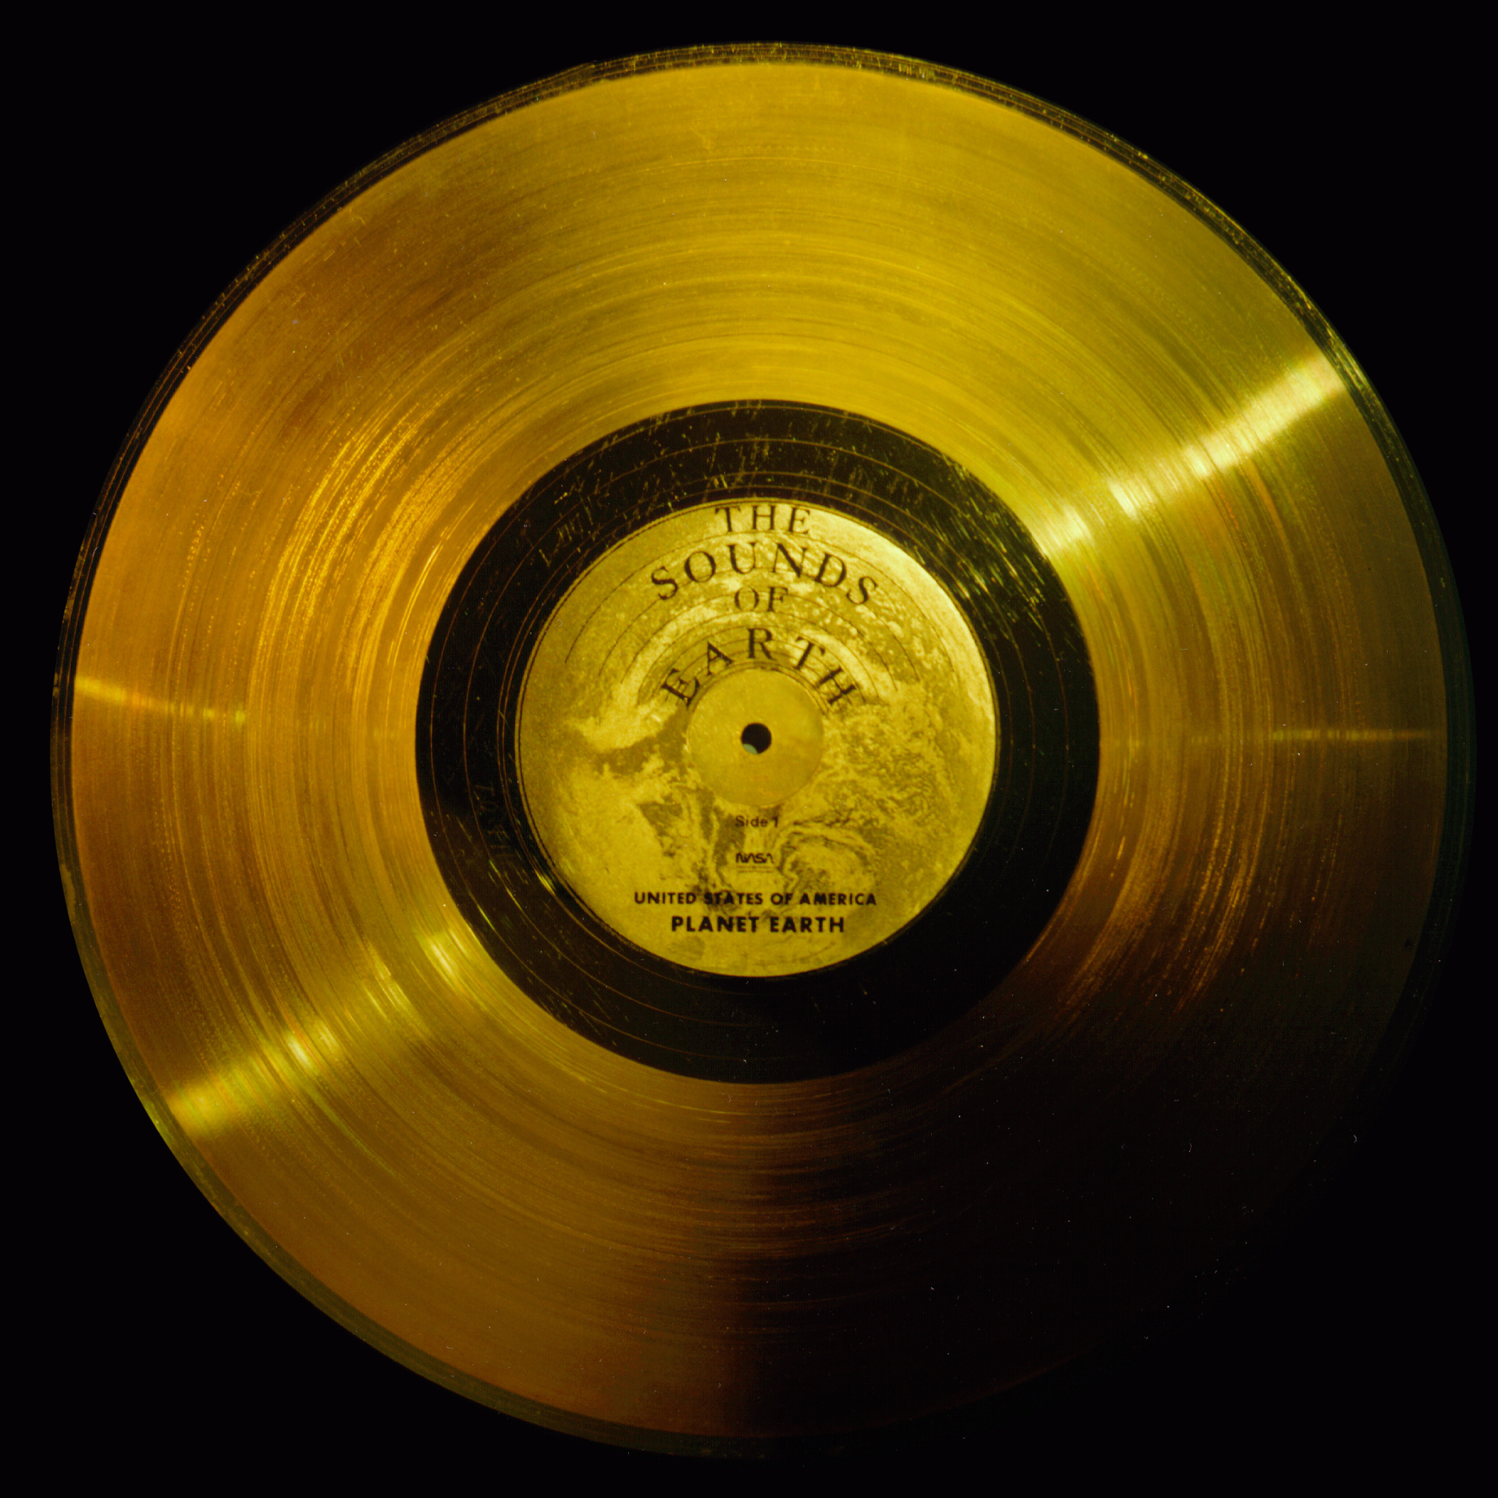
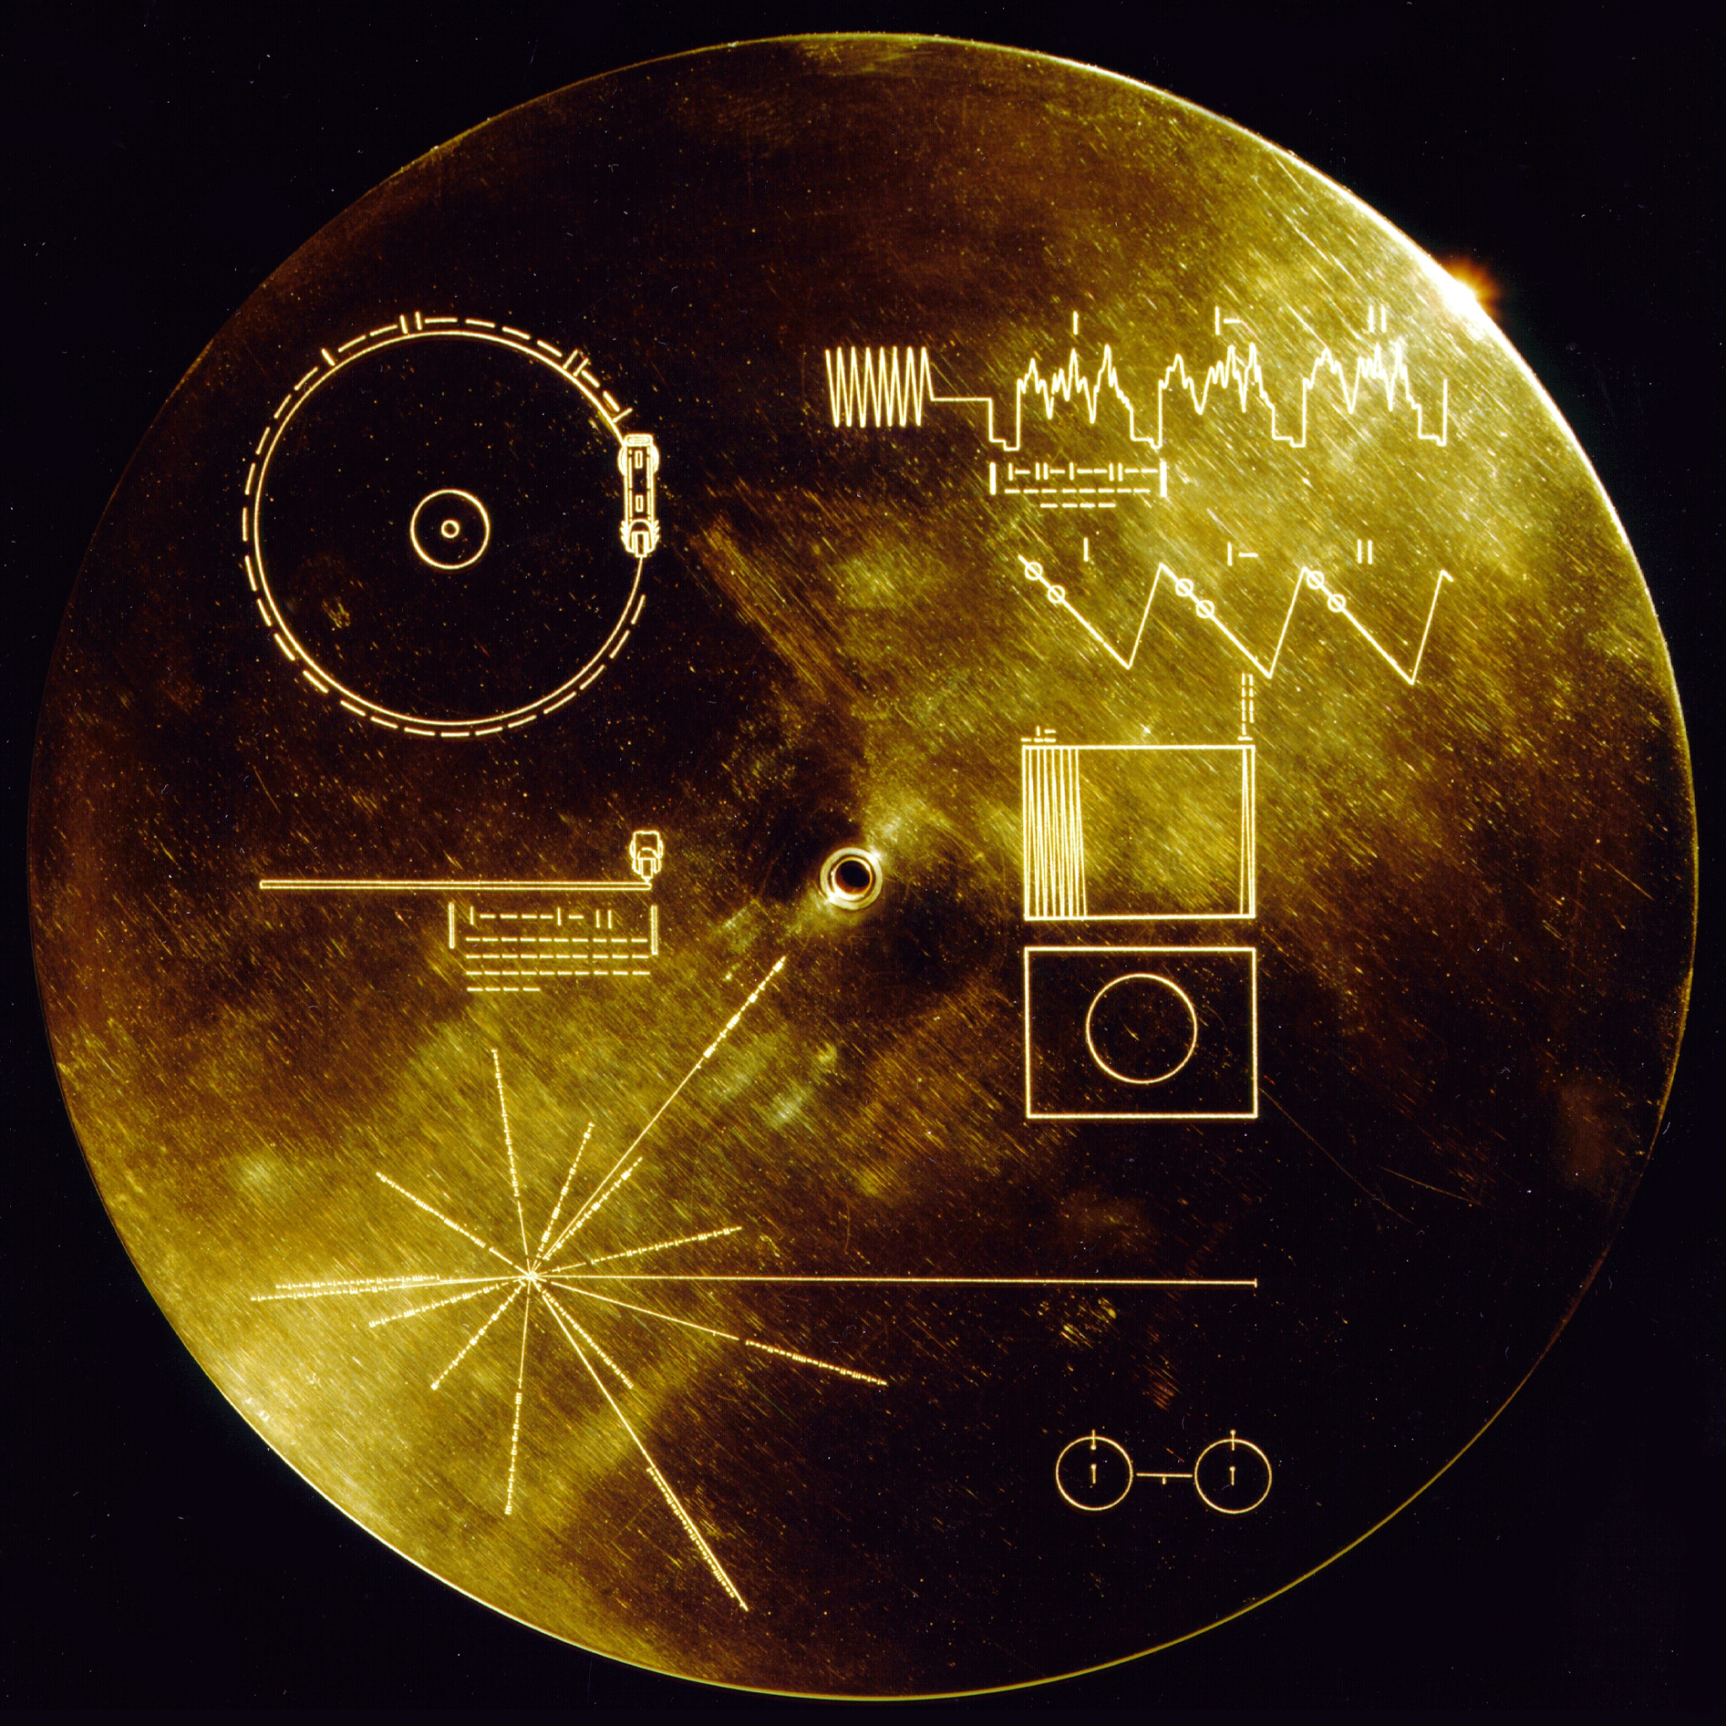
Notes:
https://upload.wikimedia.org/wikipedia/commons/5/56/The_Sounds_of_Earth_Record_Cover_-_GPN-2000-001978.jpg
https://upload.wikimedia.org/wikipedia/commons/7/7b/The_Sounds_of_Earth_-_GPN-2000-001976.jpg

Slide 33
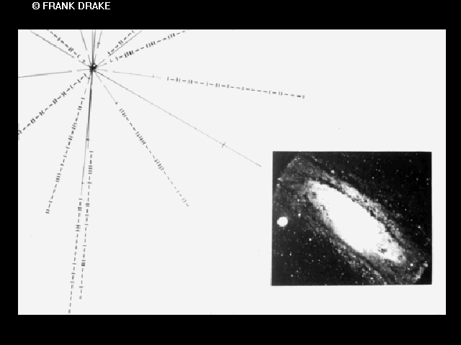
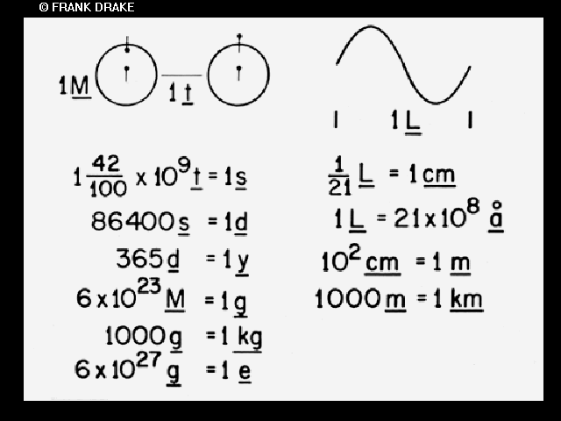

Slide 34
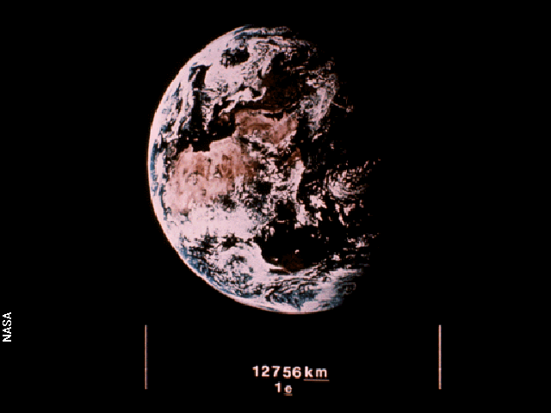

Slide 35
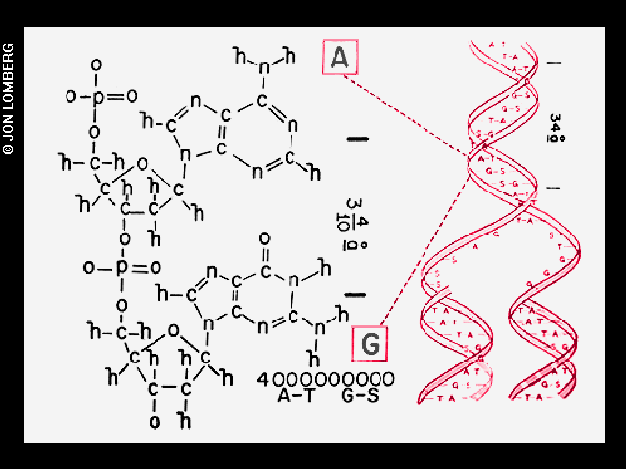
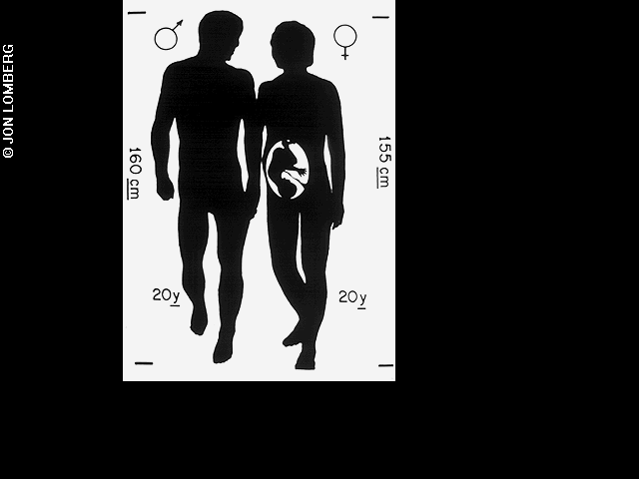

Slide 36
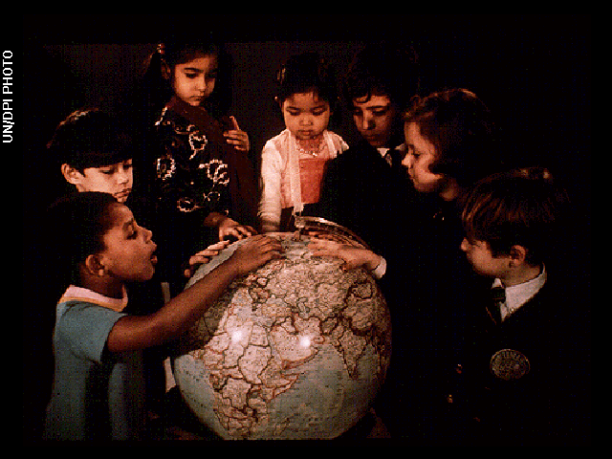
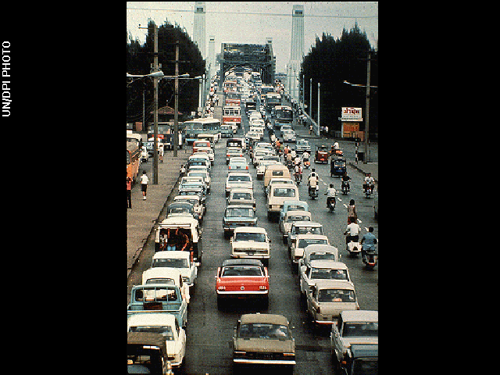

Slide 37
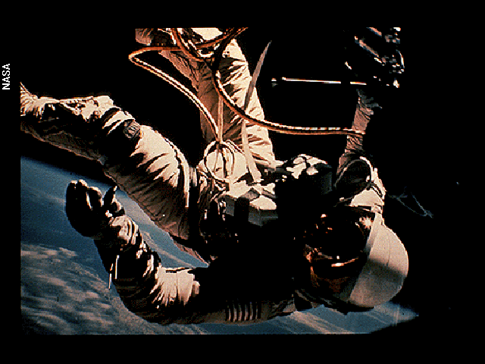
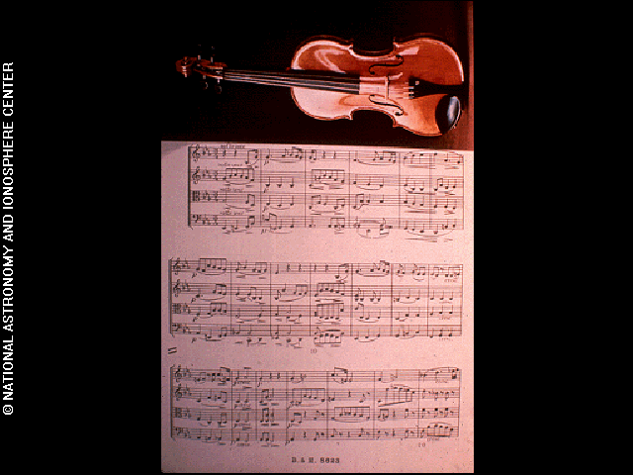

Slide 38
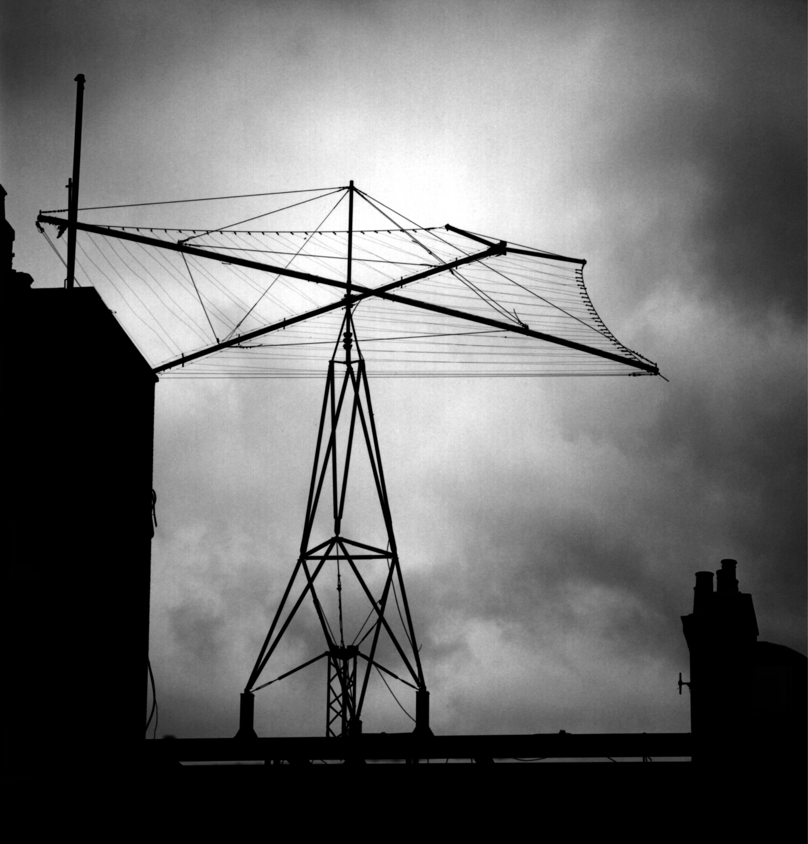
Notes:
https://99percentinvisible.org/app/uploads/2013/12/dorchester_antenna_closeup.jpeg

Slide 39
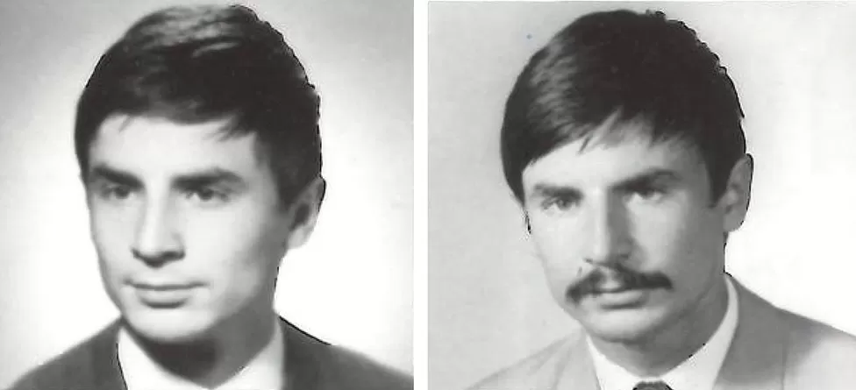
Notes:
https://ichef.bbci.co.uk/news/976/cpsprodpb/EA57/production/_93219995_jelinek976.jpg.webp

Slide 40
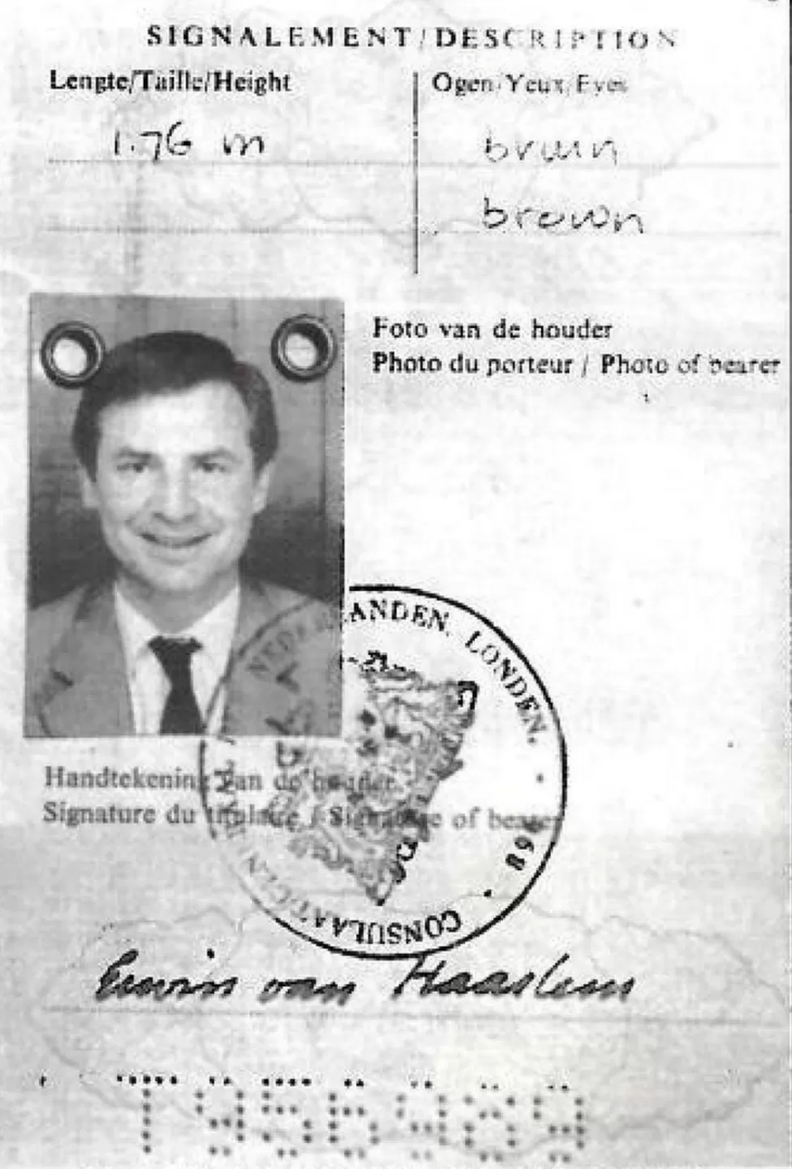
Notes:
https://ichef.bbci.co.uk/news/976/cpsprodpb/9344/production/_92900773_pp.jpg.webp

Slide 41
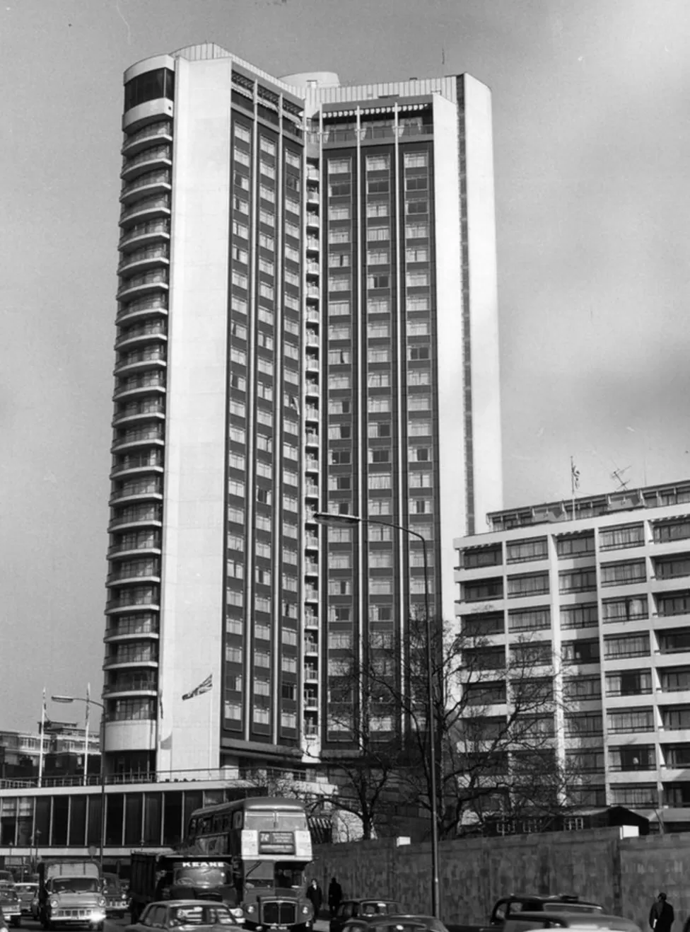
Notes:
https://ichef.bbci.co.uk/news/976/cpsprodpb/339A/production/_92901231_hilton.jpg.webp

Slide 42
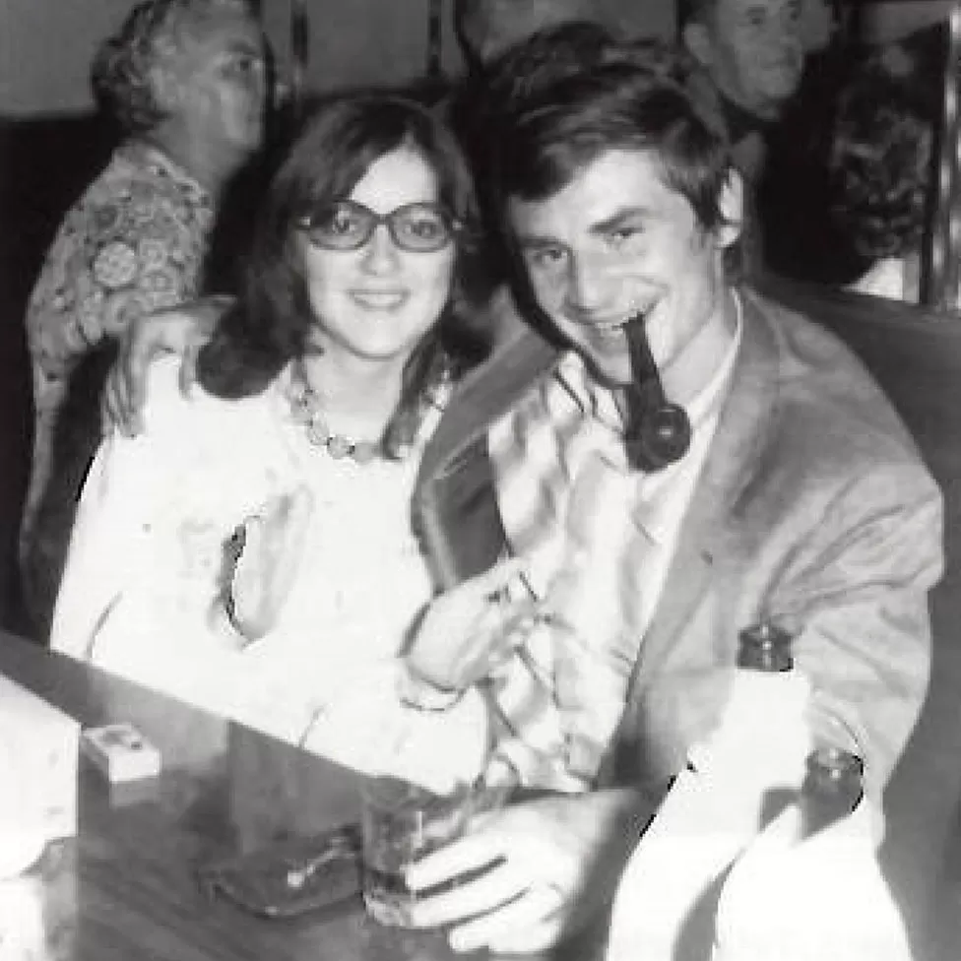
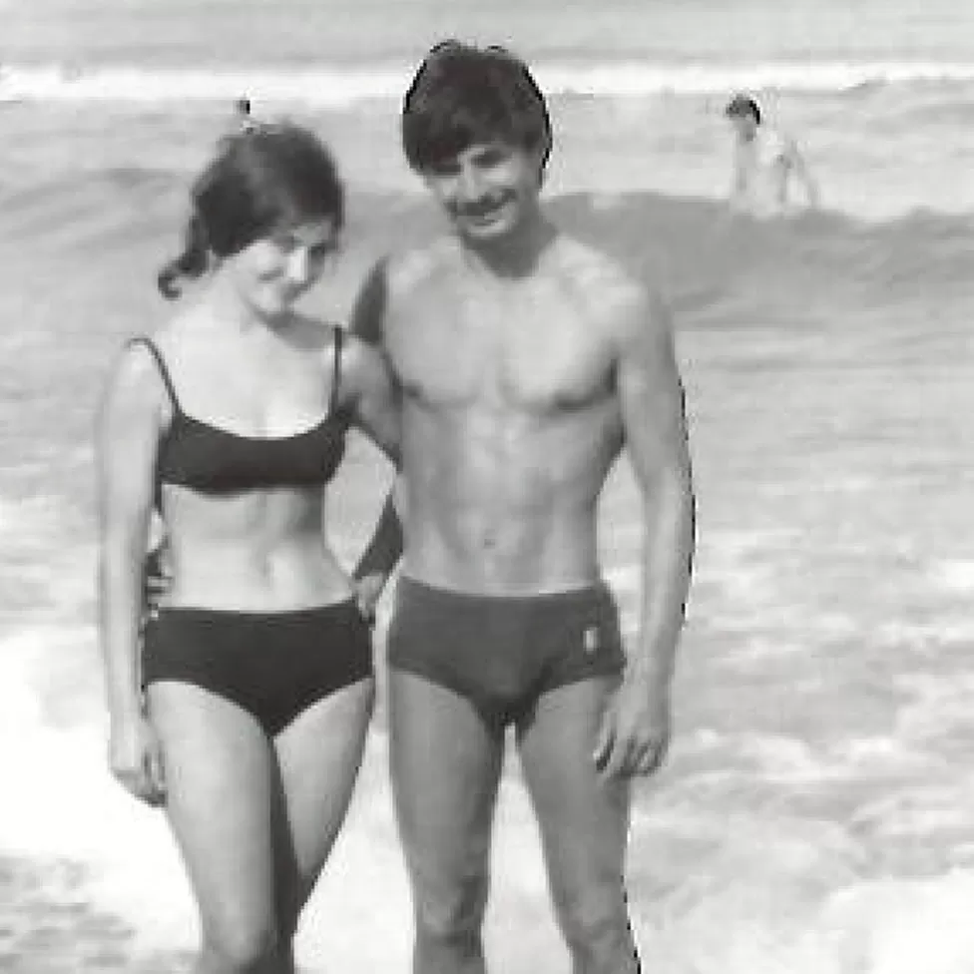

Slide 43
TVÁ MATKA SE TĚ SNAŽÍ NAJÍT V ČESKOSLOVENSKU ZA POMOCI ČERVENÉHO KŘÍŽE. POKUD TĚ VYHLEDAJÍ, DOMLUVTE SI SCHŮZKU.

Slide 44
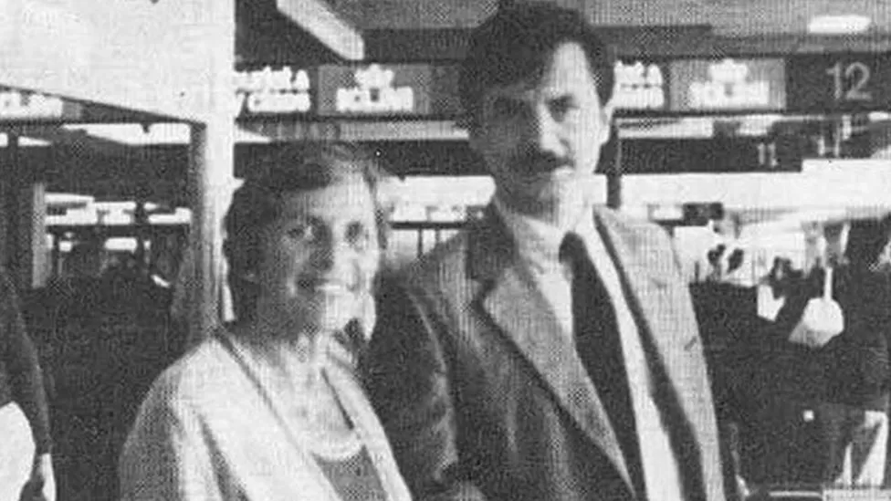
Notes:
https://ichef.bbci.co.uk/news/976/cpsprodpb/9AB0/production/_92900693_withj.jpg.webp

Slide 45
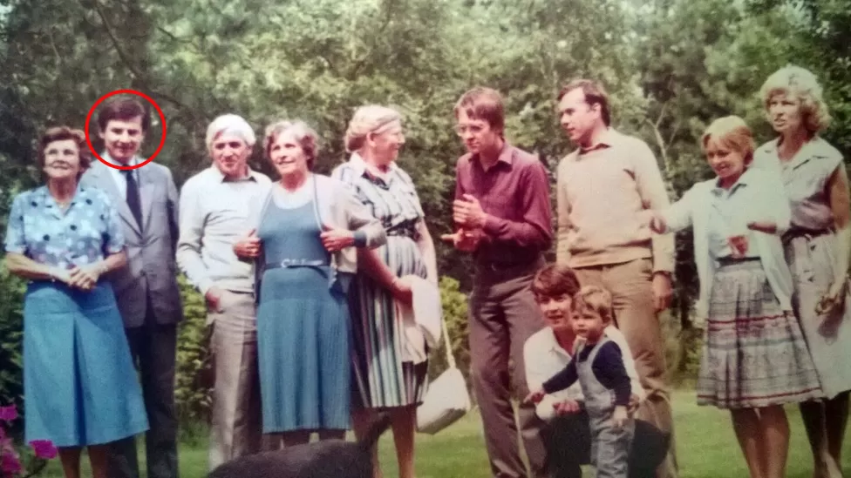
Notes:
https://ichef.bbci.co.uk/news/976/cpsprodpb/F302/production/_92901226_fam2.jpg.webp

Slide 46
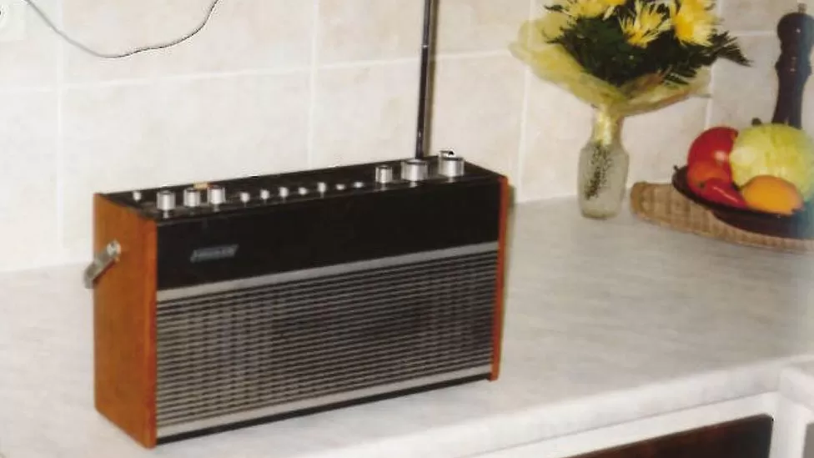

Slide 47
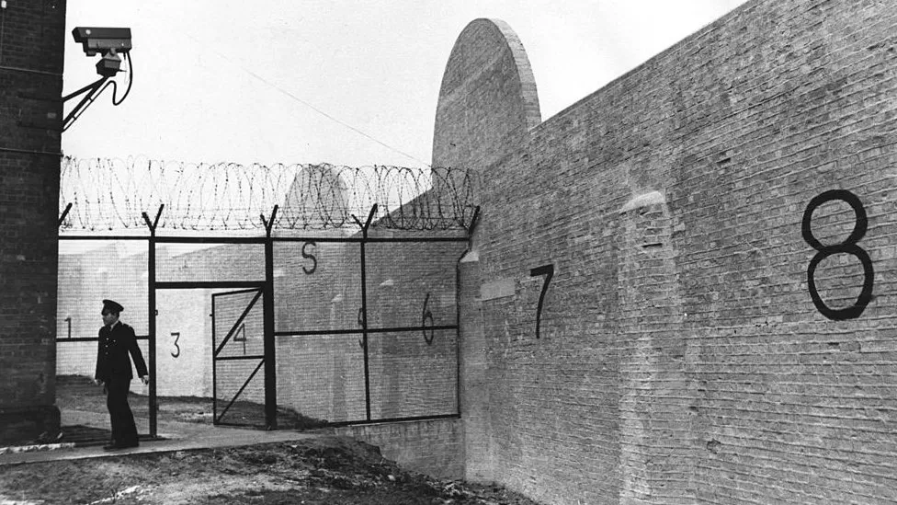

Slide 49
Notes:
https://media.pitchfork.com/photos/5931b5db9726246adc7c32b2/master/w_658,h_574,c_limit/1347c5c1.jpeg

Slide 52
Zdroje a dodatky
https://chamik.eu/plnoc23

Slide 53
Díky za pozornost ❤️

